Slide 1
MySQL Implementation
Dong Yang

Slide 2
Importing Data
In MySQL console:
Use DB_NAME
Source PATH
Example:
use yelp_db
source D:/yelp_db.sql

Slide 3
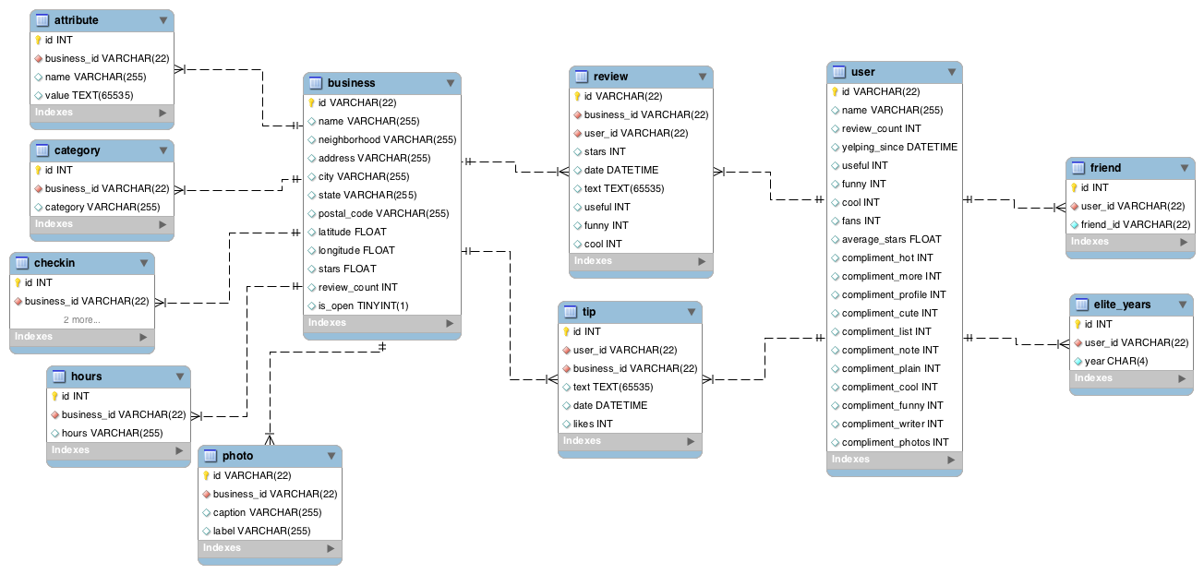
Original Data Schema

Slide 4
Filter out non-Pitt Information: Business related tables
INSERT INTO business_pitt SELECT * FROM business WHERE business.city = "Pittsburgh"
INSERT INTO category_pitt SELECT * FROM category WHERE category.business_id IN (SELECT id FROM business_pitt)
INSERT INTO checkin_pitt SELECT * FROM checkin WHERE checkin.business_id IN (SELECT id FROM business_pitt)
INSERT INTO hours_pitt SELECT * FROM hours WHERE hours.business_id IN (SELECT id FROM business_pitt)
INSERT INTO attribute_pitt SELECT * FROM attribute WHERE attribute.business_id IN (SELECT business_pitt.id FROM business_pitt)

Slide 5
Filter out non-Pitt Information: Review and Tip
INSERT INTO review_pitt SELECT * FROM review WHERE review.business_id IN (SELECT id FROM business_pitt)
INSERT INTO tip_pitt SELECT * FROM tip WHERE tip.business_id IN (SELECT id FROM business_pitt)

Slide 6
Filter out non-Pitt Information: User
SELECT *
FROM user
WHERE user.id IN ((SELECT DISTINCT review_pitt.user_id FROM review_pitt) UNION (SELECT DISTINCT tip_pitt.user_id FROM tip_pitt))
SELECT *
FROM elite_years
WHERE elite_years.user_id IN (SELECT user_pitt.id FROM user_pitt)

Slide 7
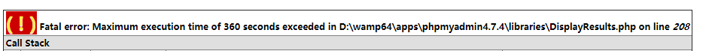
Friend Table too big! (5GB, around 49000000 tuples)
PHPAdmin
Console
Solution
1.Create a friend_temp table that contains 1/12 part of friend table
INSERT INTO friend_temp SELECT * FROM friend LIMIT 4000000;
2.Delete these tuples in original friend table
DELETE FROM friend WHERE 1=1 LIMIT 4000000;
3.Filter pitt friend using friend_temp table
INSERT INTO friend_pitt SELECT * FROM friend_temp WHERE friend_temp.user_id IN (SELECT user_pitt.id FROM user_pitt);
4.Empty friend_temp table and repeat 1-4 until friend is empty

Slide 8
Plan： Process original field
In review and tip:
Date: YYYY-MM-DD XX:XX:XX
Slice into Year month day
In checkin
Data: Friday-20:00 Friday-21:00 Friday-3:00
Slice into Friday 20:00, Friday 21:00, Friday 3:00
Further Group into Friday Evening, Friday Midnight

Slide 9
OLTP query
SELECT C.category, AVG(R.stars)
FROM category_pitt C,business_pitt B,review_pitt R
WHERE C.business_id = B.id AND B.id = R.business_id
GROUP BY C.category

Slide 10
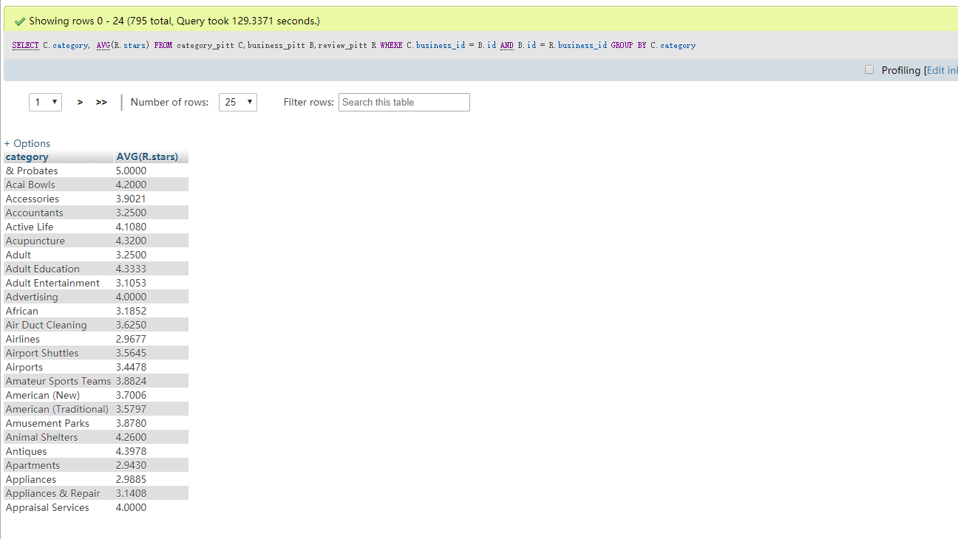

Slide 11
OLAP: Dimension Table
Concept： Check in Dimension table:
business_id
business_name
category
day_of_the_week
time_of_day
check_in_count

Slide 12
OLAP query
Check check in number for different restuarant(by name) on different time slot
SELECT business_name,day_of_the_week ,time_of_day ,sum(check_in_count)
FROM CheckinDim
GROUP BY business_name,day_of_the_week,time_of_day

Slide 13
OLAP query
Check check in number for different category on different time slot
SELECT category,day_of_the_week ,time_of_day ,sum(check_in_count)
FROM CheckinDim
GROUP BY category,day_of_the_week,time_of_day

Slide 14
Roll-up
Aggregate any one of above to check check in numer in different time slot
Example:
INSERT INTO category_check_in_dim
SELECT category,day_of_the_week ,time_of_day ,sum(check_in_count)
FROM CheckinDim
GROUP BY category,day_of_the_week,time_of_day
SELECT day_of_the_week,time_of_day ,sum(check_in_count)
FROM category_check_in_dim
GROUP BY day_of_the_week,time_of_day

Slide 15
Current Problem
The table is big! Even though the table is reasonably small, the following loading query:
INSERT INTO dim
SELECT B.name, B.id, C.category, CI.date, CI.count
FROM business_pitt B, category_pitt C, checkin_pitt CI
WHERE B.id = C.business_id AND B.id = CI.business_id
will generate a dimension table reaching to 120 GB (And I’m not sure even why).

Slide 16
Current planning Approach
1. Store not the most low level dimension table but the slightly aggregated ones.
2. Slice original table into chunks and finish insertion step by step like when dealing with the friend table.
Intending to write a java driver file to finish this work by program.

Slide 17
Some possible query
1, Does the duration of being a elite user have effect on rating stars a user give?
2, Does the duration of being a elite user have effect on the number of reviews a user give?
3, What is the trend in change of rating star for different category of stores in yearly basis?
4, For store remain opening and closed, is there a different in ratings and review account?

Slide 18
Business Owner Query
1, At each time slot how many costumers will come to my store?
2, For my costumers, what is the average amount of reviews?
3, How many user have their friend visited our store?
4, Comparing with other store in the same category, how is my store’s rating? How is the number of reviews? The number of coming costumers?
5, What other category of stores my costumer also go to?

